Slide 1


Slide 2


About Instacart
Online grocery ordering app, store
Aims to deliver groceries in an hour

Slide 3
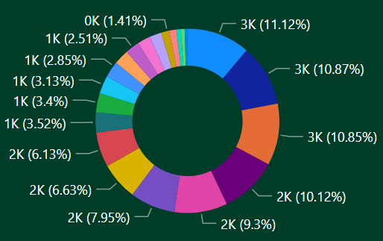
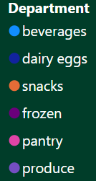
Customer Behaviour
Here, 11.12% of customers made purchase in beverage department & 10.87% of customers has made a purchase in Dairy eggs & Snacks
All the three Beverages, Dairy egg & snacks are very close, So this department might attract customer more than other department.

Slide 4
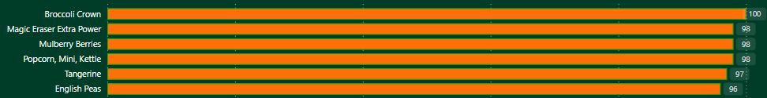
Product Analysis
Here you can see Broccoli Crown is the most popular product among 49,588 which comes under the Fresh Vegetable( Aisel ) & Produce ( Department )

Slide 5
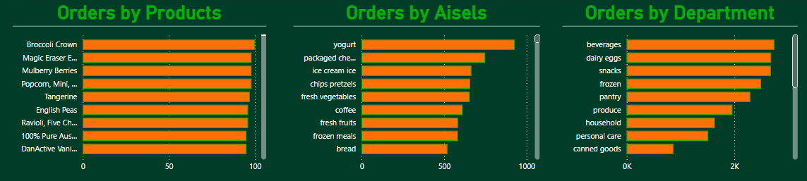
Order
As the above analysis shows, Broccoli crown has the more order in products
When it comes Aisels, Yogurt has the highest orders
By department, Beverages has more orders compared to other departments

Slide 6
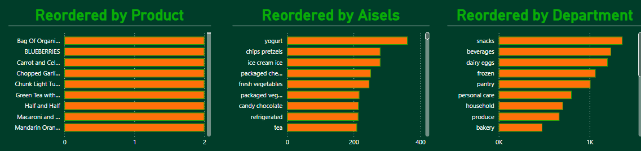
Re-Ordered
As the above analysis shows, Bag of organic lemon has the more re-order in products
When it comes Aisels, Yogurt has the highest re-orders
By department, Snacks has more re-orders compared to other departments

Slide 7
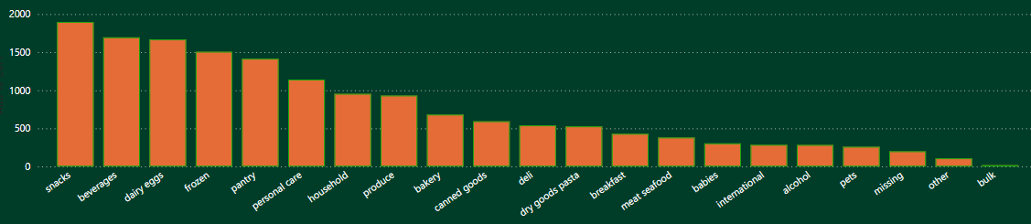
Add-To-Cart
As the chart shows, 1896(12%) products from snacks department has been add-to-cart by customer followed by 1695(10.73%) beverage products & 1667(10.55%) dairy eggs

Slide 8
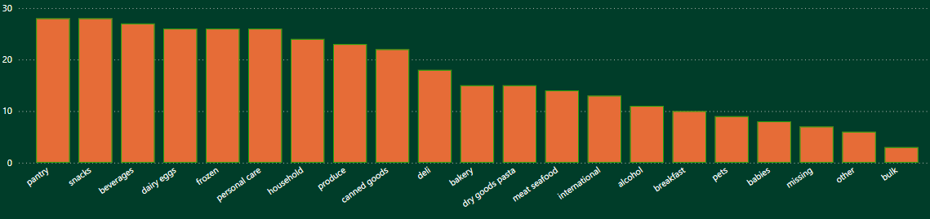
Prior orders
Pantry (7.8%) and Snacks(7.8%) as the most prior orders when compared to other department
And coffee (3%) has the highest prior order when compared other aisels

Slide 9
Suggestions
Tailored Marketing for Customer Segments
Seasonal Marketing Strategies
Preventing Customer Attrition
Offering Product Bundles and Deals
Promotion of Related Products

Slide 10
THANK YOU

